Slide 1
Speech to Speech Translator (v1.0)
By Bradley Lamitie

Slide 2
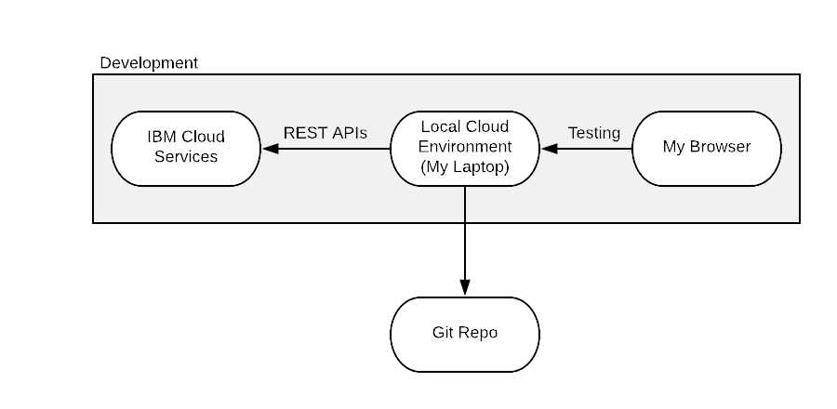
Architecture

Slide 3
Components
This project depends on the following:
Maven
spring-boot-starter-web
spring-boot-starter-thymeleaf
ibm core
ibm speech-to-text
ibm language-translator
ibm text-to-speech

Slide 4
Requirements
Develop a cloud application using Cloud services via REST APIs, and deploy it across cloud providers.

Slide 5
Project Description
Speech to Speech Translator allows the user to translate from multiple languages to several options. The application uses IBM services to convert your voice to text, translate the text to another language, and then convert the translated text to speech using a voice you choose. This application could be helpful when traveling. If you(A native English speaker) were to travel to a foreign country, and were unable to speak their language, you could have them speak into the application and hear what they say in plain english. Then, you could speak plain English into the application to reply back to the person.

Slide 6
Project Description
The web application offers multiple languages to translate to and from like:
* English
* Portuguese
* Japanese
* Arabic
* Spanish
* Chinese
* German
* Korean
* French
* Italian

Slide 7
Scope and Risks
I decided to develop a project that would use 3 IBM services to translate speech to another language and out putting it.
Some risks I knew when choosing my project including the limited time I would have to complete the project (especcially because I have other classes), limited budget(using free tier application and services), and occasionally running into issues. Unfortunately unknown risks(Medical issues) played a part and I wasn't able to finish deploying to AWS. So I must accept the points off and try to gget as much credit as possible.

Slide 8
Milestones
Some major milestones I intended to reach included getting the Speech-to-text, Translation, and Text-to-speech services to work independantly and to integrate them together. Also to deploy the application in a web application, deploy it to a docker container, and move it to the cloud. Unfortunately, I was unable to move it to the cloud, as the microphone settings did not work in AWS Elastic Beanstalk.

Slide 9
Cost Estimates & Stakeholders
The cost for the project is free. All of the applications and Services are running on free tier. However, the project did cost me many hours of sleep, as I seemed to have chosen a much more complicated and in depth route.
Stakeholders include the person who assigned this project, Dr. Jinho Hwang, as well as myself, Bradley Lamitie.

Slide 10
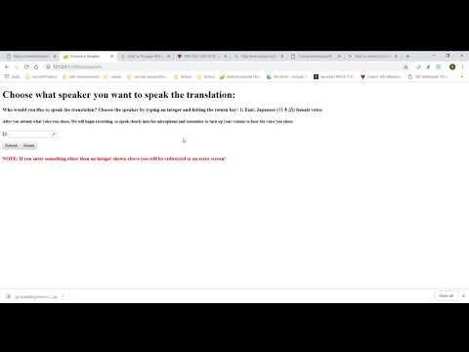
Project Demonstration
NOTE: My mic didnt pick up the sudio output from the program, so i encourage you to try it!

Slide 11
Thank You

